Slide 1
Date and Time class in java

Slide 2
Using LocalDate, LocalTime and LocalDateTime
The most commonly used classes are LocalDate, LocalTime and LocalDateTime. As their names indicate, they represent the local Date/Time from the context of the observer.
These classes are mainly used when timezone are not required to be explicitly specified in the context

Slide 3
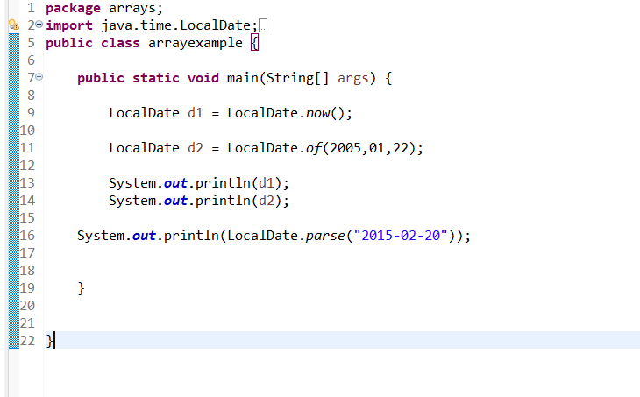
Working With LocalDate
The LocalDate represents a date in ISO format (yyyy-MM-dd) without time.
It can be used to store dates like birthdays and paydays.

Slide 4
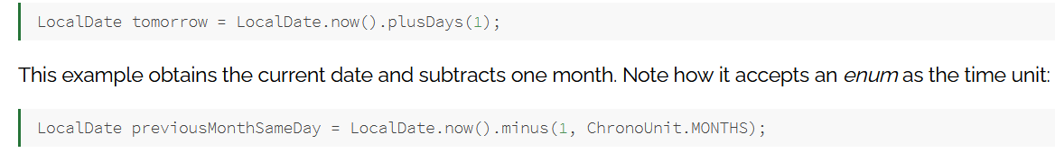
The following code snippet gets the current local date and adds one day:

Slide 5
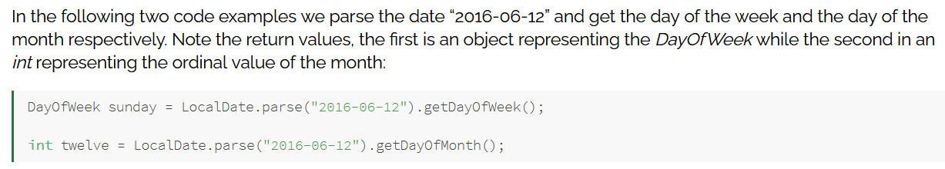

Slide 6
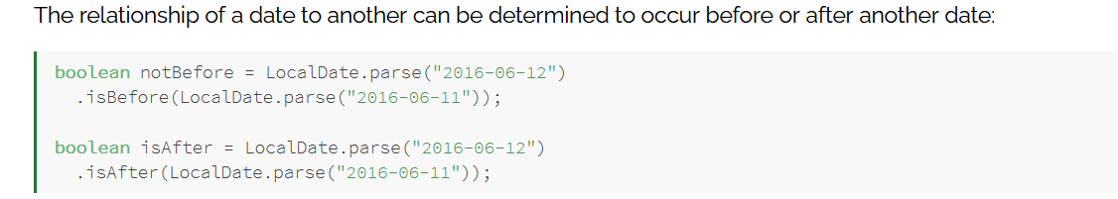

Slide 7

Working With LocalTime
The LocalTime represents time without a date.
Similar to LocalDate an instance of LocalTime can be created from system clock or by using “parse” and “of” method.

Slide 8
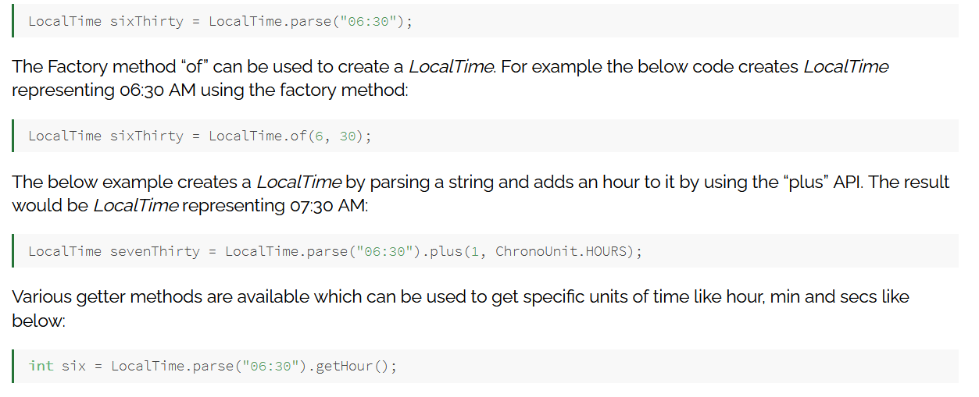

Slide 9

Working With LocalDateTime

Slide 10
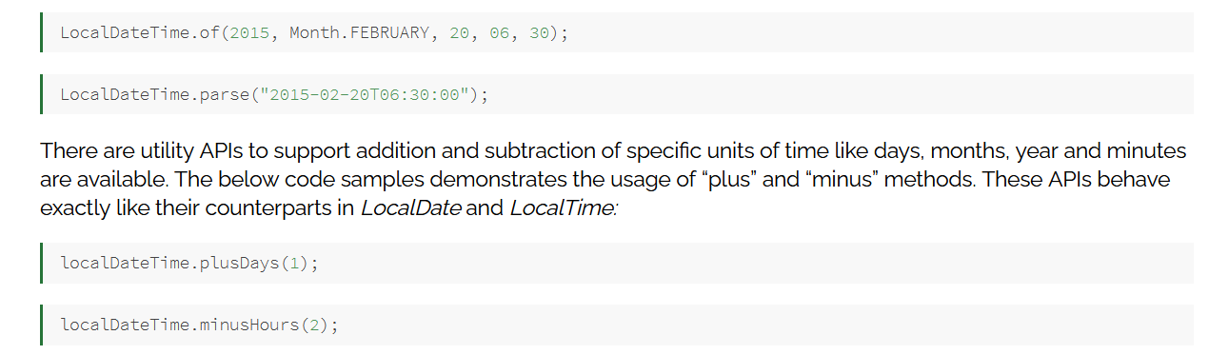

Slide 11
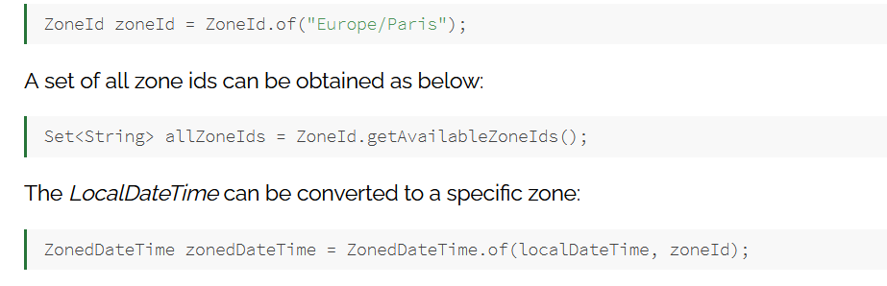
Using ZonedDateTime API

Slide 12
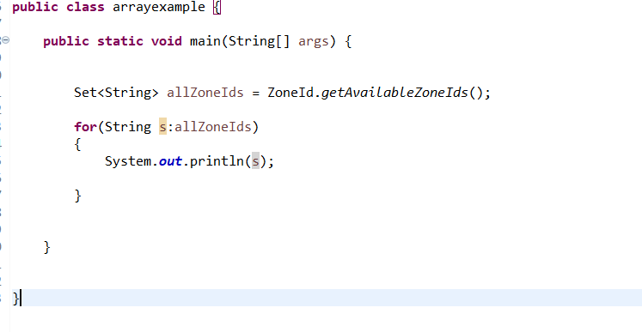

Slide 13
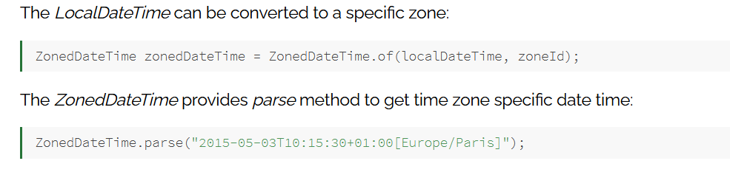

Slide 14
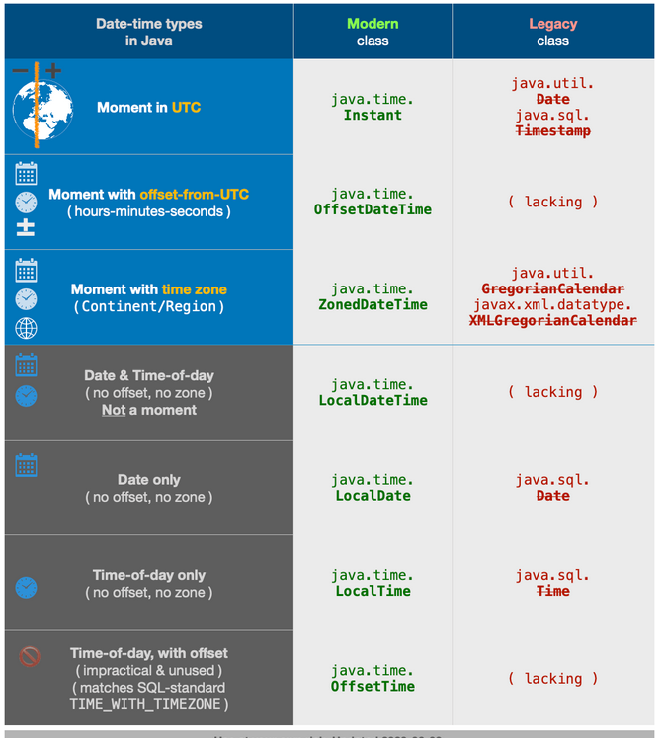

Slide 15
import java.time.*;
import java.util.*;
public class arrayexample {
public static void main(String[] args) {
ZoneId id=ZoneId.of("Libya");
ZonedDateTime t=ZonedDateTime.now(id);
System.out.println("Paris time is"+t);
Set<String> zoneids=ZoneId.getAvailableZoneIds();
for(String s:zoneids)
{
System.out.println(s);
}
System.out.println(id);
}
}

